Slide 1
Using forecasts to understand change
17 November 2022
Nathan Thomas, Principal Workforce Analyst
Workforce Intelligence Team (East of England)

Slide 2
Introduction
Aim was understand how the COVID-19 pandemic had affected NHS staff sickness absence rates.
Questions of interest included:
By how much did COVID-19 change sickness absence rates?
How did this change itself vary over time and at different points in the course of the pandemic?
How might this information be used to develop better forecasts of future sickness absence rates?
I attempted to answer these questions by using pre-pandemic sickness absence data to forecast what sickness absence rates could have looked like if the pandemic never happened, then comparing the forecasts with actual observed rates and measuring the difference.

Slide 3
Choosing a forecasting method
The monthly sickness absence rate data to be modelled have the following characteristics:
They change over time
They vary by a range of factors including staff group, provider, and season (pre-pandemic, total sickness absence rates were generally higher in winter)
They potentially involve trends (consistent increases or decreases in level over time, distinct from seasonal variation)
Exponential smoothing handles time series trends using weighted averages of past observations, with the weights decaying exponentially as the observations get older (the more recent the observation, the higher the associated weight).
State space models use exponential smoothing to identify up to three components of the time series: the level, the trend, and the seasonality.
This approach allows us to plausibly model time series data with the identified characteristics.

Slide 4
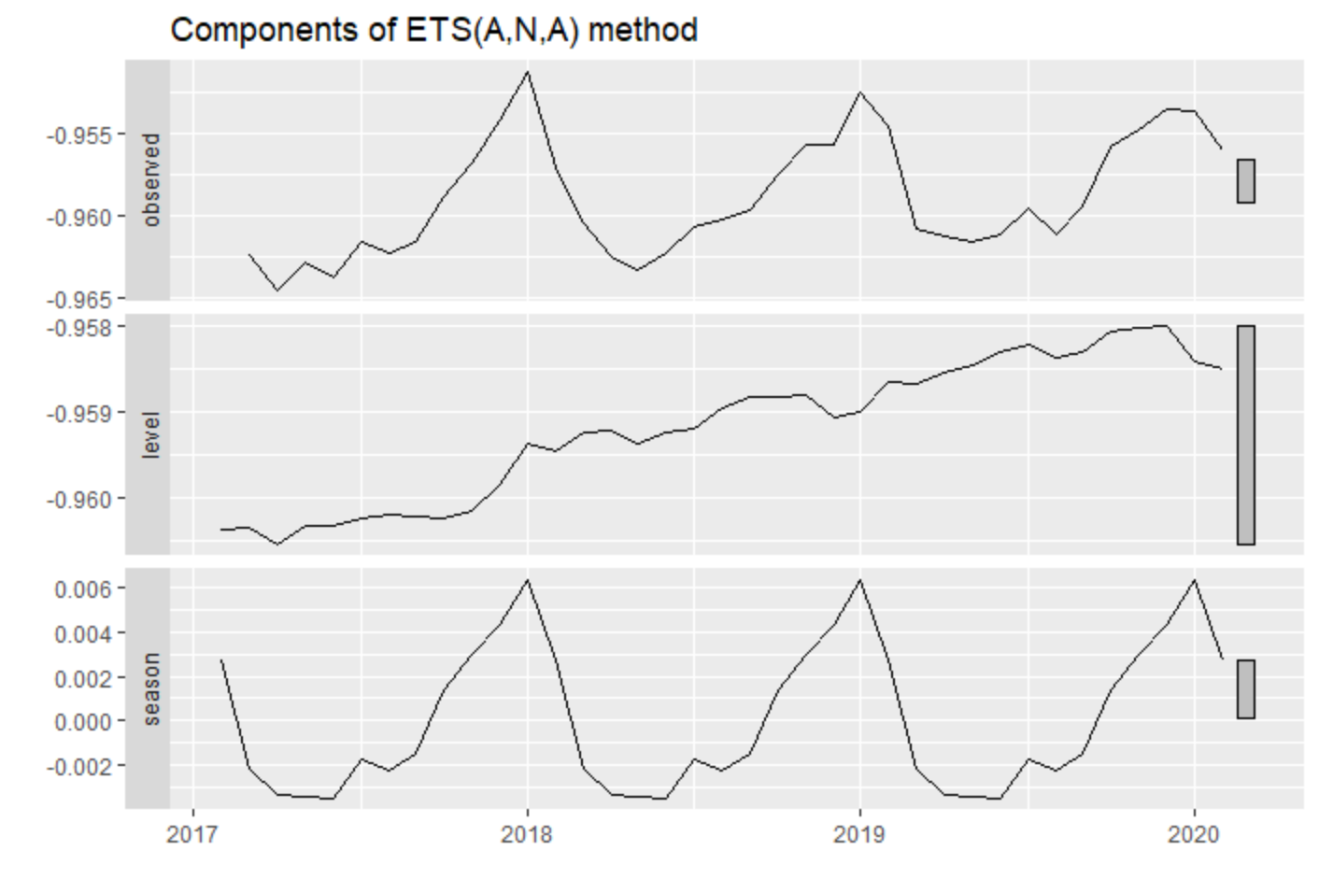
Creating the model
Forecast function in Excel uses exponential smoothing, but does not offer control over key parameters of the model.
Time series of monthly sickness absence rate data from March 2017 onwards was loaded into R.
The data were split into the three years of data prior to March 2020 (pre-COVID) and the remainder (post-COVID).
The forecast package was then used to create a state space model of the training data.
Box-Cox transformation was applied to improve normality of residuals (see Model diagnostics).
forecast automatically determines the model that fits the training data best, which in this case is an ETS(A,N,A) model.
This means that the level has additive errors, there is no trend, and the seasonal errors are also additive (i.e. they do not change with the level).

Slide 5
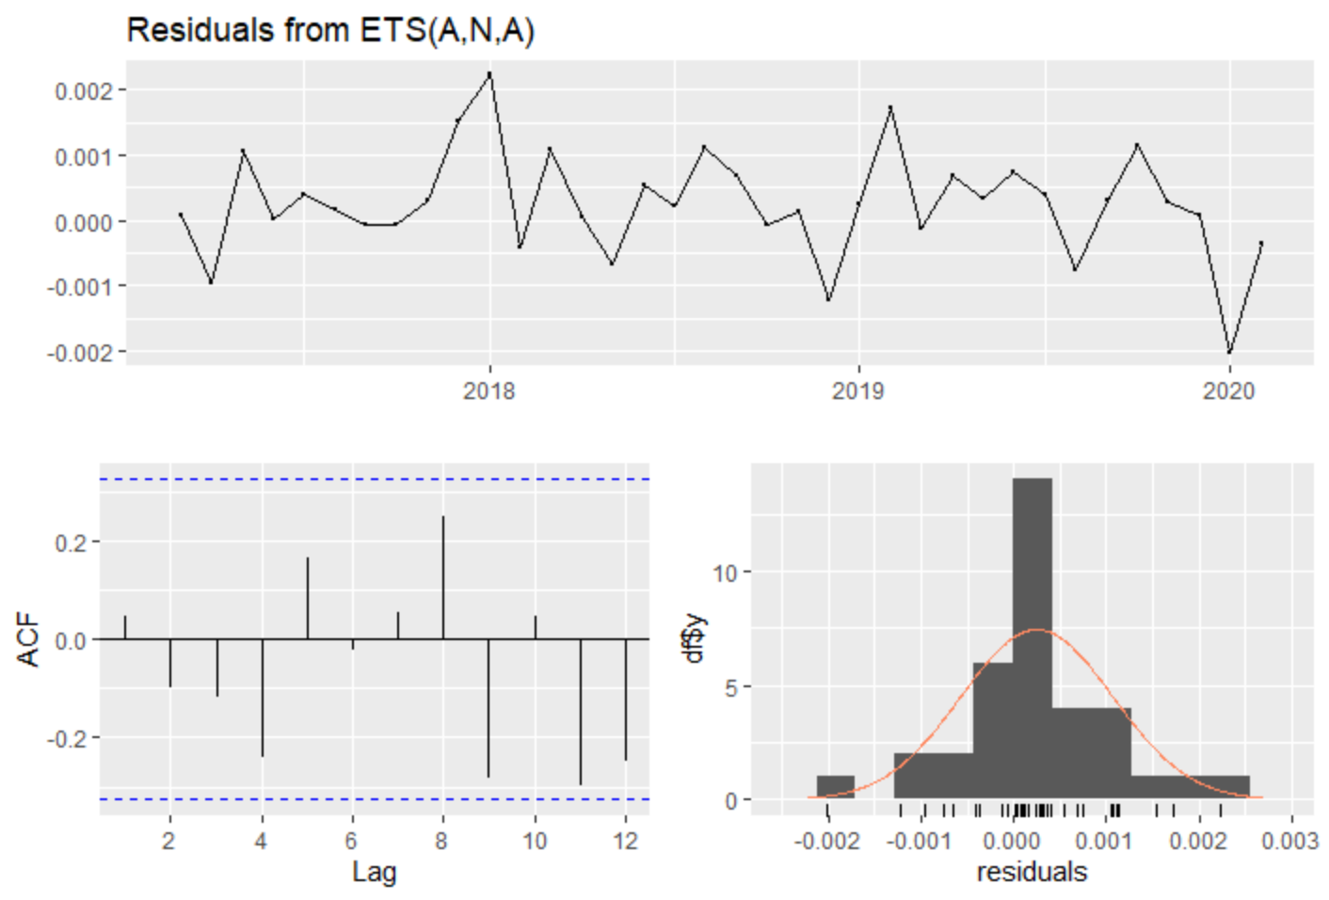
Model diagnostics
Residual plot suggests residuals are randomly scattered around a mean of zero.
ACF plot suggests that residuals are not correlated – however the result of a Box-Ljung test shows otherwise, indicating that the model can be improved.
Histogram looks ‘normal-ish’ – only 36 data points.
Extensive tweaking of the model produced very minor changes to the forecasts, so simpler model was retained.
“All models are wrong, but some are useful” (Box).

Slide 6
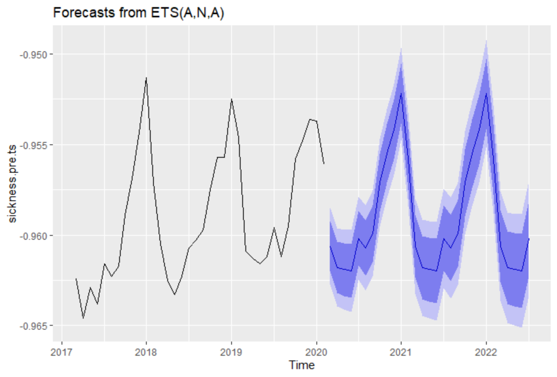
Forecasting
Black line shows the observed (transformed) data.
Purple line shows point forecasts, dark purple band shows 80% prediction intervals, light purple band shows 95% prediction intervals.

Slide 7
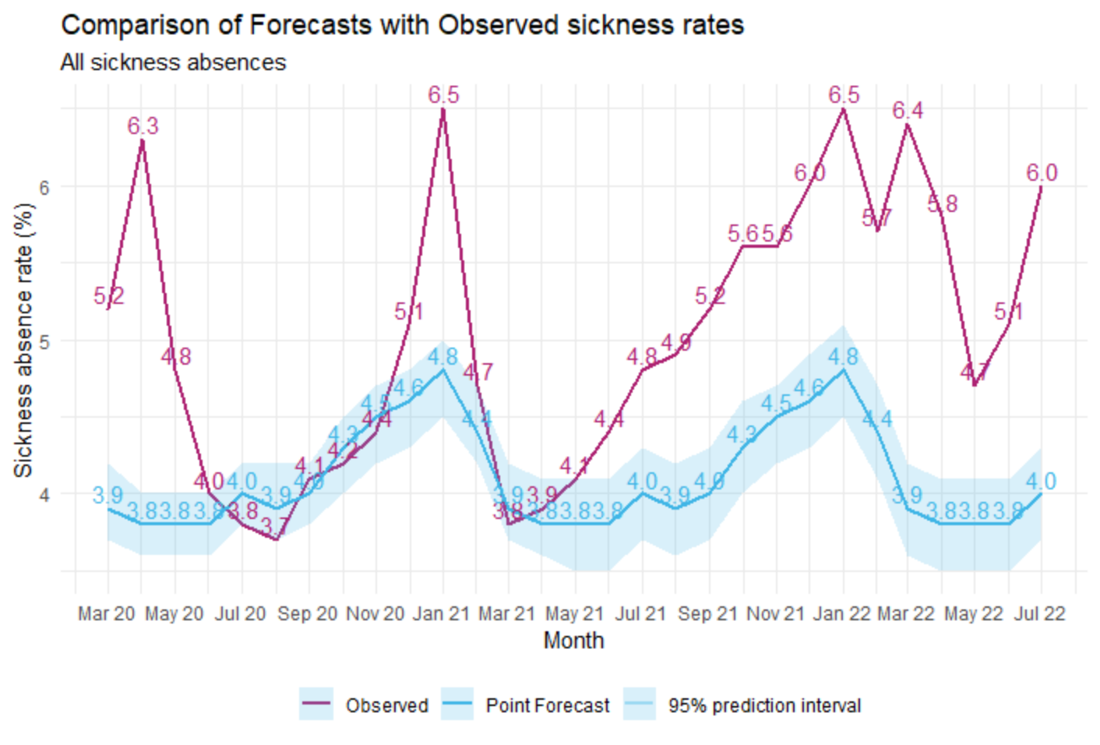
Comparing with observations
Comparison shows observed sickness absence greatly exceeding forecast during the first two waves of the COVID-19 pandemic in April 2020 and January 2021.
Between these waves, and immediately after the second wave, observed sickness absence falls back to forecast.
Following the removal of social restrictions in mid-2021, observed sickness absence increases again and remains higher than forecast.
2022 has seen more frequent waves occurring every 12-15 weeks; this was used to successfully forecast the recent October wave.

Slide 8
Conclusion
Comparing forecasts with observed data can be used to understand changes in NHS staff sickness absence that occurred as a result of the COVID-19 pandemic, and to inform projections of future sickness absence.
The application of this technique is not limited to sickness absence data – many subjects for which a robust historical dataset exists can be analysed in this manner.
For example, the observed impact of an intervention can be compared with a forecast of what could have happened had the intervention not been made.
For more information and R code, contact nathan.thomas@hee.nhs.uk.
Any questions?

Slide 9
References
Hyndman and Athanasopoulos (2018). Forecasting: Principles and Practice (2nd ed.). Available at https://otexts.com/fpp2/

